Slide 1
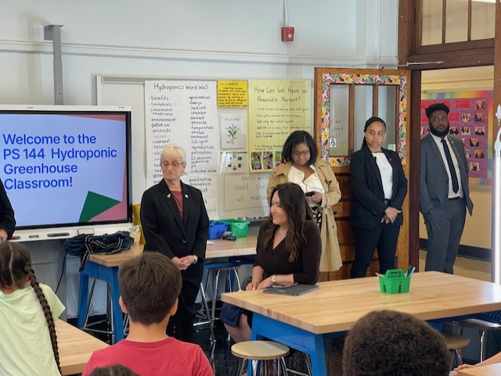
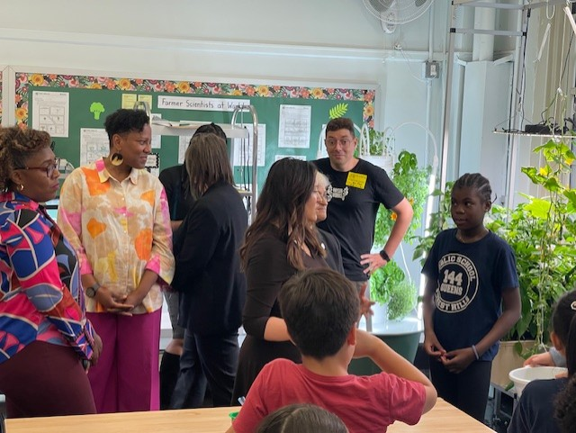

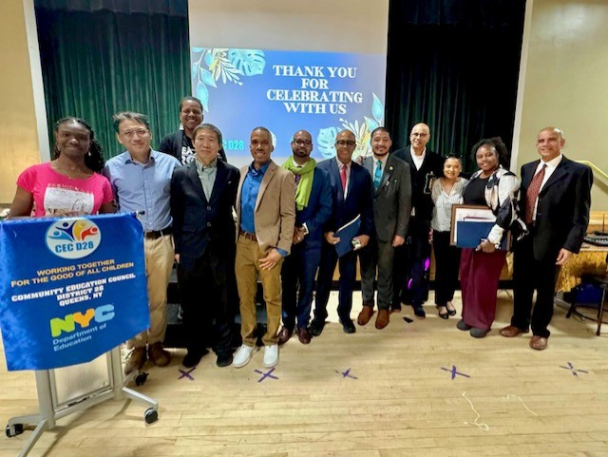
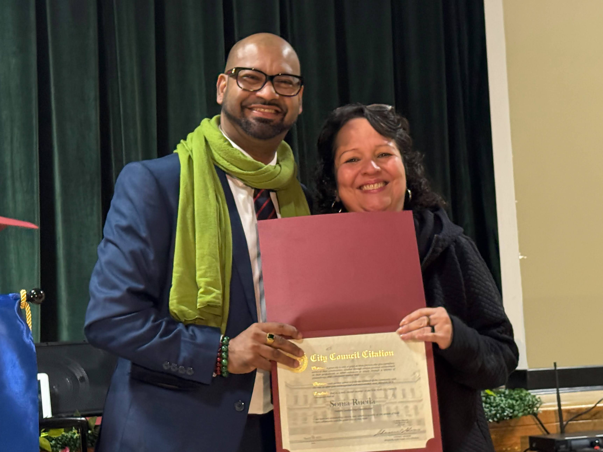
Literacy Proficiency
Math Proficiency
Chronic Absenteeism & Retention
Parent Engagement
Community
Superintendent
Dr. Eric L. Blake
June 12, 2025
Deputy Superintendent
Dr. Shonelle Hall
“With effort and support all schools can meet the needs of their students and help them achieve outstanding educational outcomes”

Slide 2
District 28 Vision, Mission & Goals
The United Nations' mission statement includes the line, "In this noble undertaking, cooperation, collaboration, unity, and solidarity must be the light we should seek and follow. We commit to strive for inestimable contribution to human progress."
Mission
In Community School District 28 we focus on equity as a lever for achievement for every single scholar. We are a district of excellence. We commit to every school maintaining high academic standards and working closely with families so that all scholars are learning at high levels. Beginning with school leaders, teachers, students and community partners, we also commit to being a district of learners ensuring that we promote critical thinking rooted in core content conceptual understanding through creative problem solving, technology innovation, social emotional learning and community advocacy.
Vision
In Community School District 28 we celebrate our differences because we understand that woven into those differences is the knowledge that they offer us unlimited possibility to learn and expand our knowledge of and commitment to all humanity. We are beautifully diverse, varied; coming from countless racial, ethnic, language, and belief backgrounds. We commit to striving for inestimable contribution to the lives of our scholars.

Slide 3
D28 CELEBRATES DATA SNAPSHOT – MATH/ELA
2024_25 EOY I-Ready Measure of Student Learning Scores
I-Ready ELA
At the beginning of the year, 30% of students were on, above, or approaching grade level. By the end of
the year, this percentage increased significantly to 53%.
This improvement highlights the progress made over the course of the year in ELA.
MATHEMATICS
At the beginning of the year, 21% of students were on, above, or approaching grade level. By the end of the year, this percentage had risen to 52%, representing a significant improvement of 31%.
This notable increase highlights the substantial progress made throughout the year in Mathematics.

Slide 4
D28- Celebrating Excellence in Multilingual Education
District 28 proudly celebrates its outstanding 99.3% compliance in programming for English Language Learners (ELLs), setting a citywide standard for excellence. Through unwavering commitment, the district has successfully implemented the Corrective Action Plan and ensured tailored, high-quality services for ELLs with IEPs. These accomplishments reflect District 28's dedication to inclusive, culturally responsive education and its leadership in shaping a brighter, more equitable future for all learners. 🎉

Slide 5
SPECIAL EDUCATION CELEBRATIONS
We are also thrilled to be ranked 11th in the city for Special Education, with 96% of our students fully served, reflecting our dedication to providing high-quality support for all learners. 🎉
We are at 95% (5th in the city) honor roll for the 2024-25 schoolyear, annual goals for families. . 🎉
Finally, we are one of only 4 districts in the city chosen to be a part of a pilot of innovative partnerships for Special Education. . 🎉
A heartfelt thank you to our district team and school-based staff for their unwavering dedication and hard work in achieving the goals we set together. . 🎉

Slide 6
D28 Attendance Celebrations - As of 6/10/25
Where Are We Now: June 2025
Year-to-Date (YTD) Overall Attendance:
91.5% compared to 90.0% citywide
Chronic Absenteeism YTD:
30.5% compared to 32.7% citywide
30.5% compared to 35.3% on the same date last year, representing an overall decrease of 15.7%
District 28 (D28) Achievements:
D28 has improved overall attendance more than 28 out of 32 peer Elementary/Middle School districts across the entire city.
​

Slide 7
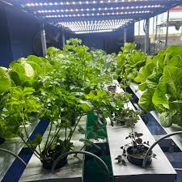

Chancellor and Councilmember Shulman’s Visit to PS 144
Thank you, Chancellor Aviles-Ramos and Council Member Shulman, for visiting
PS 144 and seeing firsthand the amazing work happening in our hydroponics lab.
We truly appreciate your support and recognition!"

Slide 8
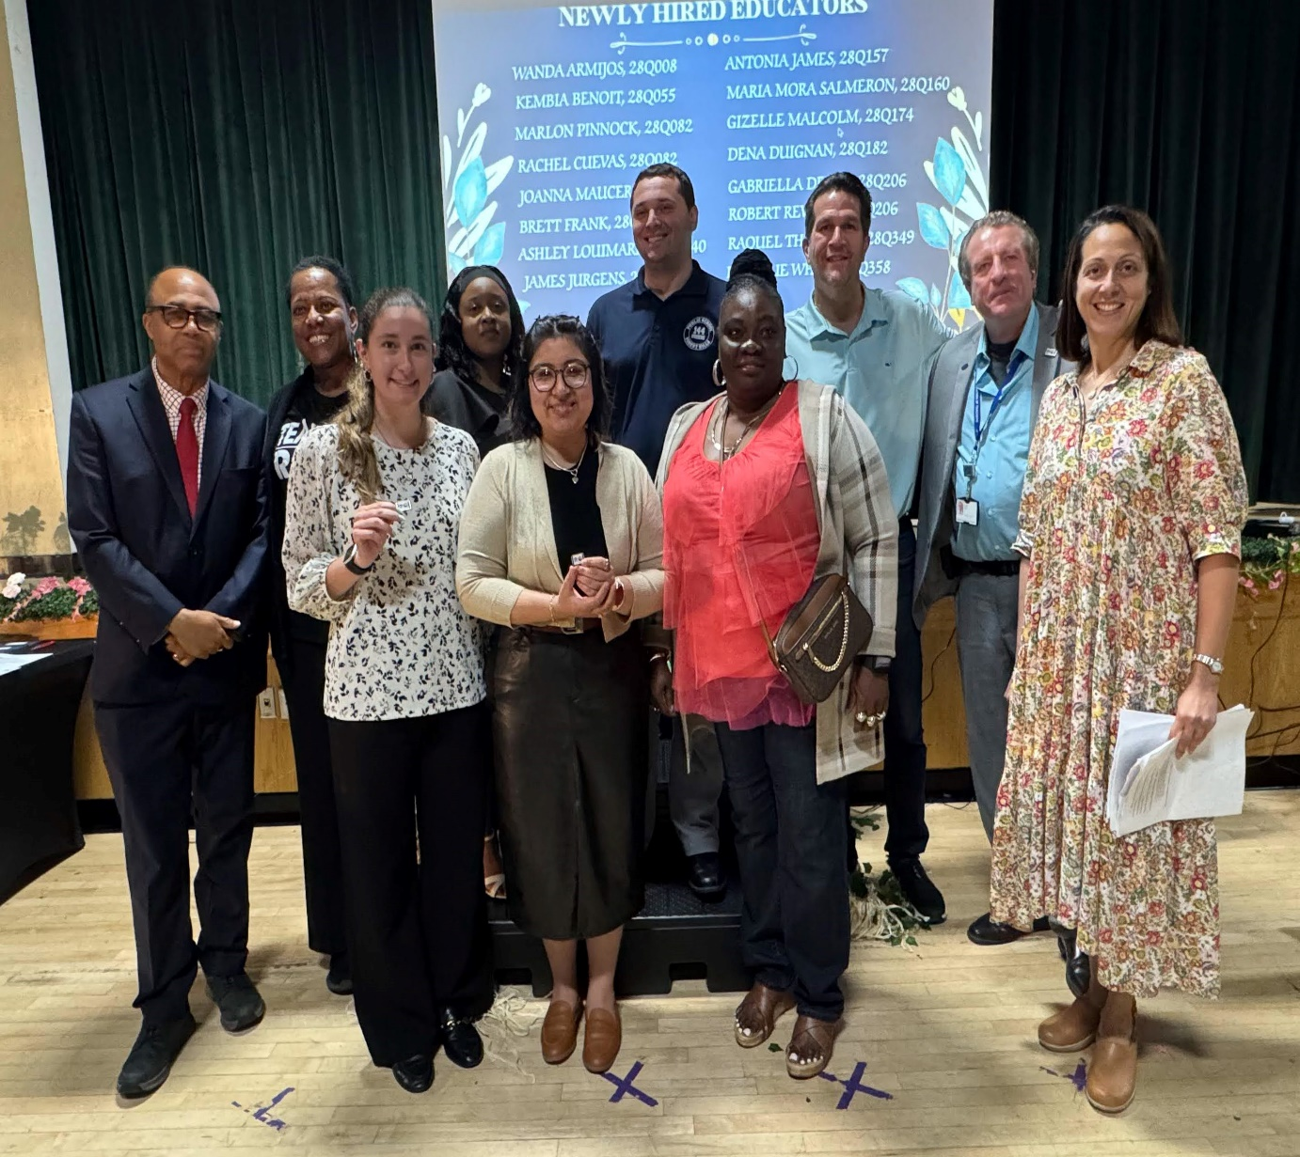
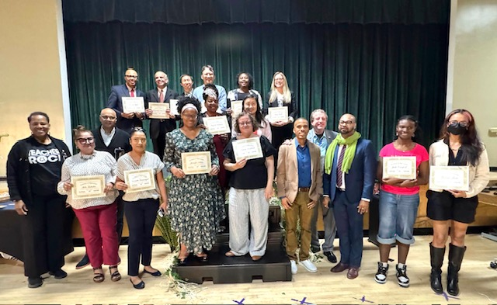
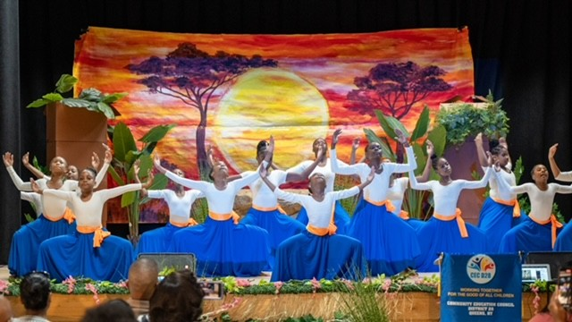
Thank You D28 CEC and UFT
We extend our heartfelt thanks to the D28 CEC for their end of year celebration and recognitions of community partners, which strengthens our collective efforts. We also want to thank the UFT for their hard work and collaboration, and for recognizing our new teachers' diligent efforts.

Slide 9

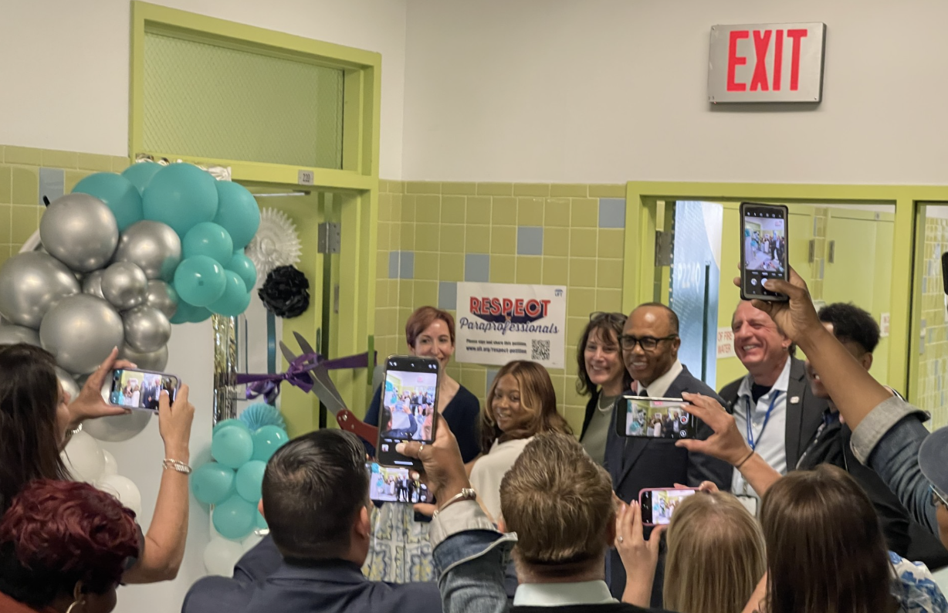
D28 Celebrates our New UFT Teacher Centers
District 28 continues to strengthen its partnership with Queens UFT by opening four new Teacher Centers to support both our outstanding new and experienced educators.
28Q349 – Principal Bates - Howell
28Q174 – Principal Dr. Lewis
28Q54 – Principal Hanley
28Q048 – Principal Duvernay
We want to thank Mr. Bruch Zihal for his continued support and partnership with District 28.

Slide 10
Thank you
Finally, I want to extend my deepest gratitude to each and every one of you. Your dedication, hard work, and unwavering support have made this year truly remarkable.
Special thanks to the offices of all our elected officials, the UFT, CSA, and DC37, all our community partners, and especially our students and families for their invaluable contributions. Let's take a moment to inhale, enjoy the Summer, and recharge our spirits. Together, we can make The Great D28 2026-2027 school year even better.
Thank you once again.

